Slide 1
Beginner’s python plot guide
Lan-Chi Ho, February 28, 20201

Slide 2
Import Libraries
import math
import numpy as np
import numpy.linalg as npla
import matplotlib.pyplot as plt
from matplotlib import cm
%matplotlib inline
np.set_printoptions(precision = 4)
from openpyxl import load_workbook

Slide 3
programming basics
Variables store data
There are many different data types that variables store
String(str) - combination of letters, numbers, or symbols
Char – one single letter
Integer (int) whole number
Float: a real number
Boolean(bool): True or false
string: “hello123”
Char: ‘a’
Integer: 4
Float: 4.25
Boolean: True (1) or False (0)

Slide 4
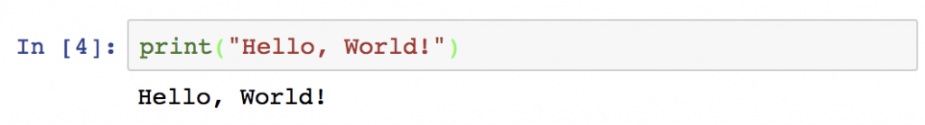
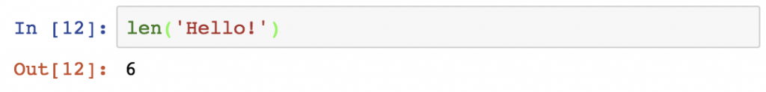
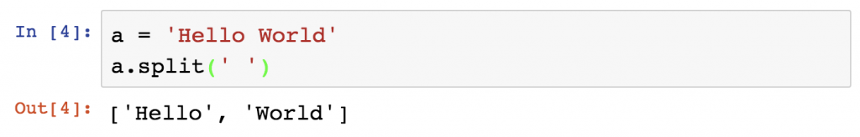
Python commands
Print()
Len()
.split(‘delimiter’)

Slide 5
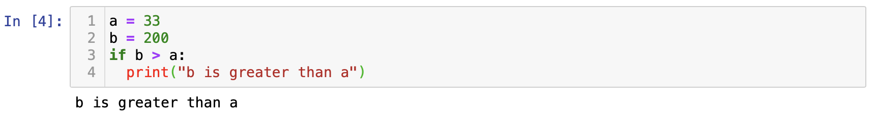
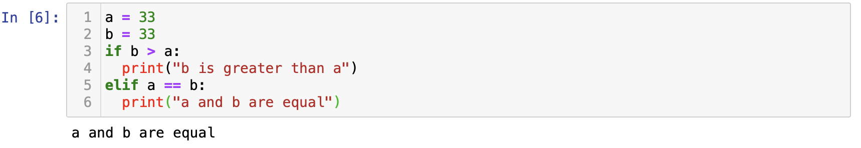
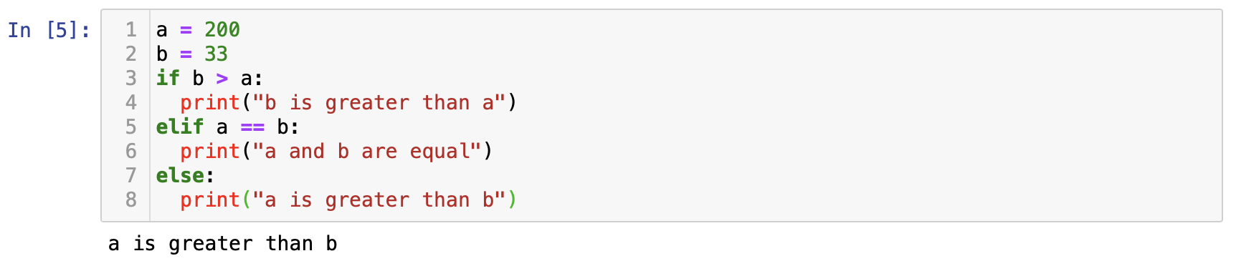
If statement
Use logical conditions to execute certain commands
Equals: a == b
Not Equals: a != b
Less than: a < b
Less than or equal to: a <= b
Greater than: a > b
Greater than or equal to: a >= b

Slide 6
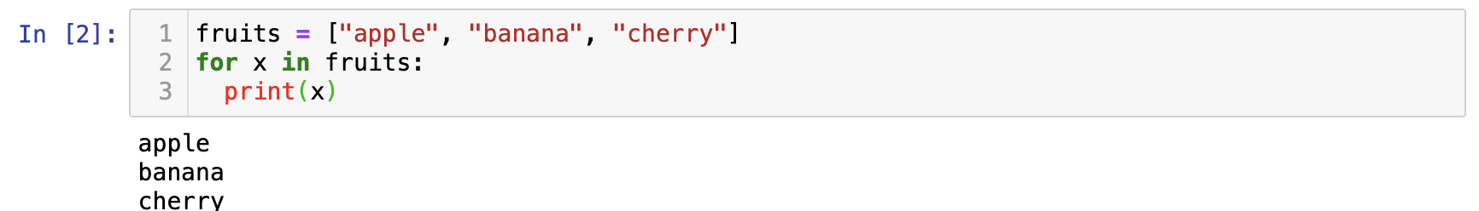
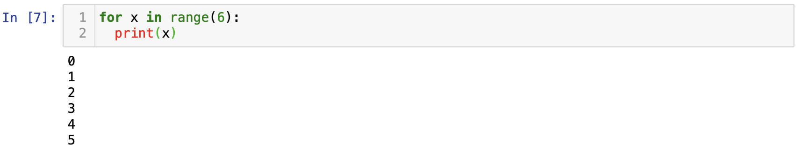
For loop
for iterating over a sequence (list, string, tuple, array, or set)

Slide 7
Indexing and slicing
Indexing- means to access an element of an iterable by its index position
In CS, index starts from 0
Slicing – getting a subset of elements from an iterable based on indexes

Slide 8
Graphing from myocyter
Amplitudes only txtfile

Slide 9
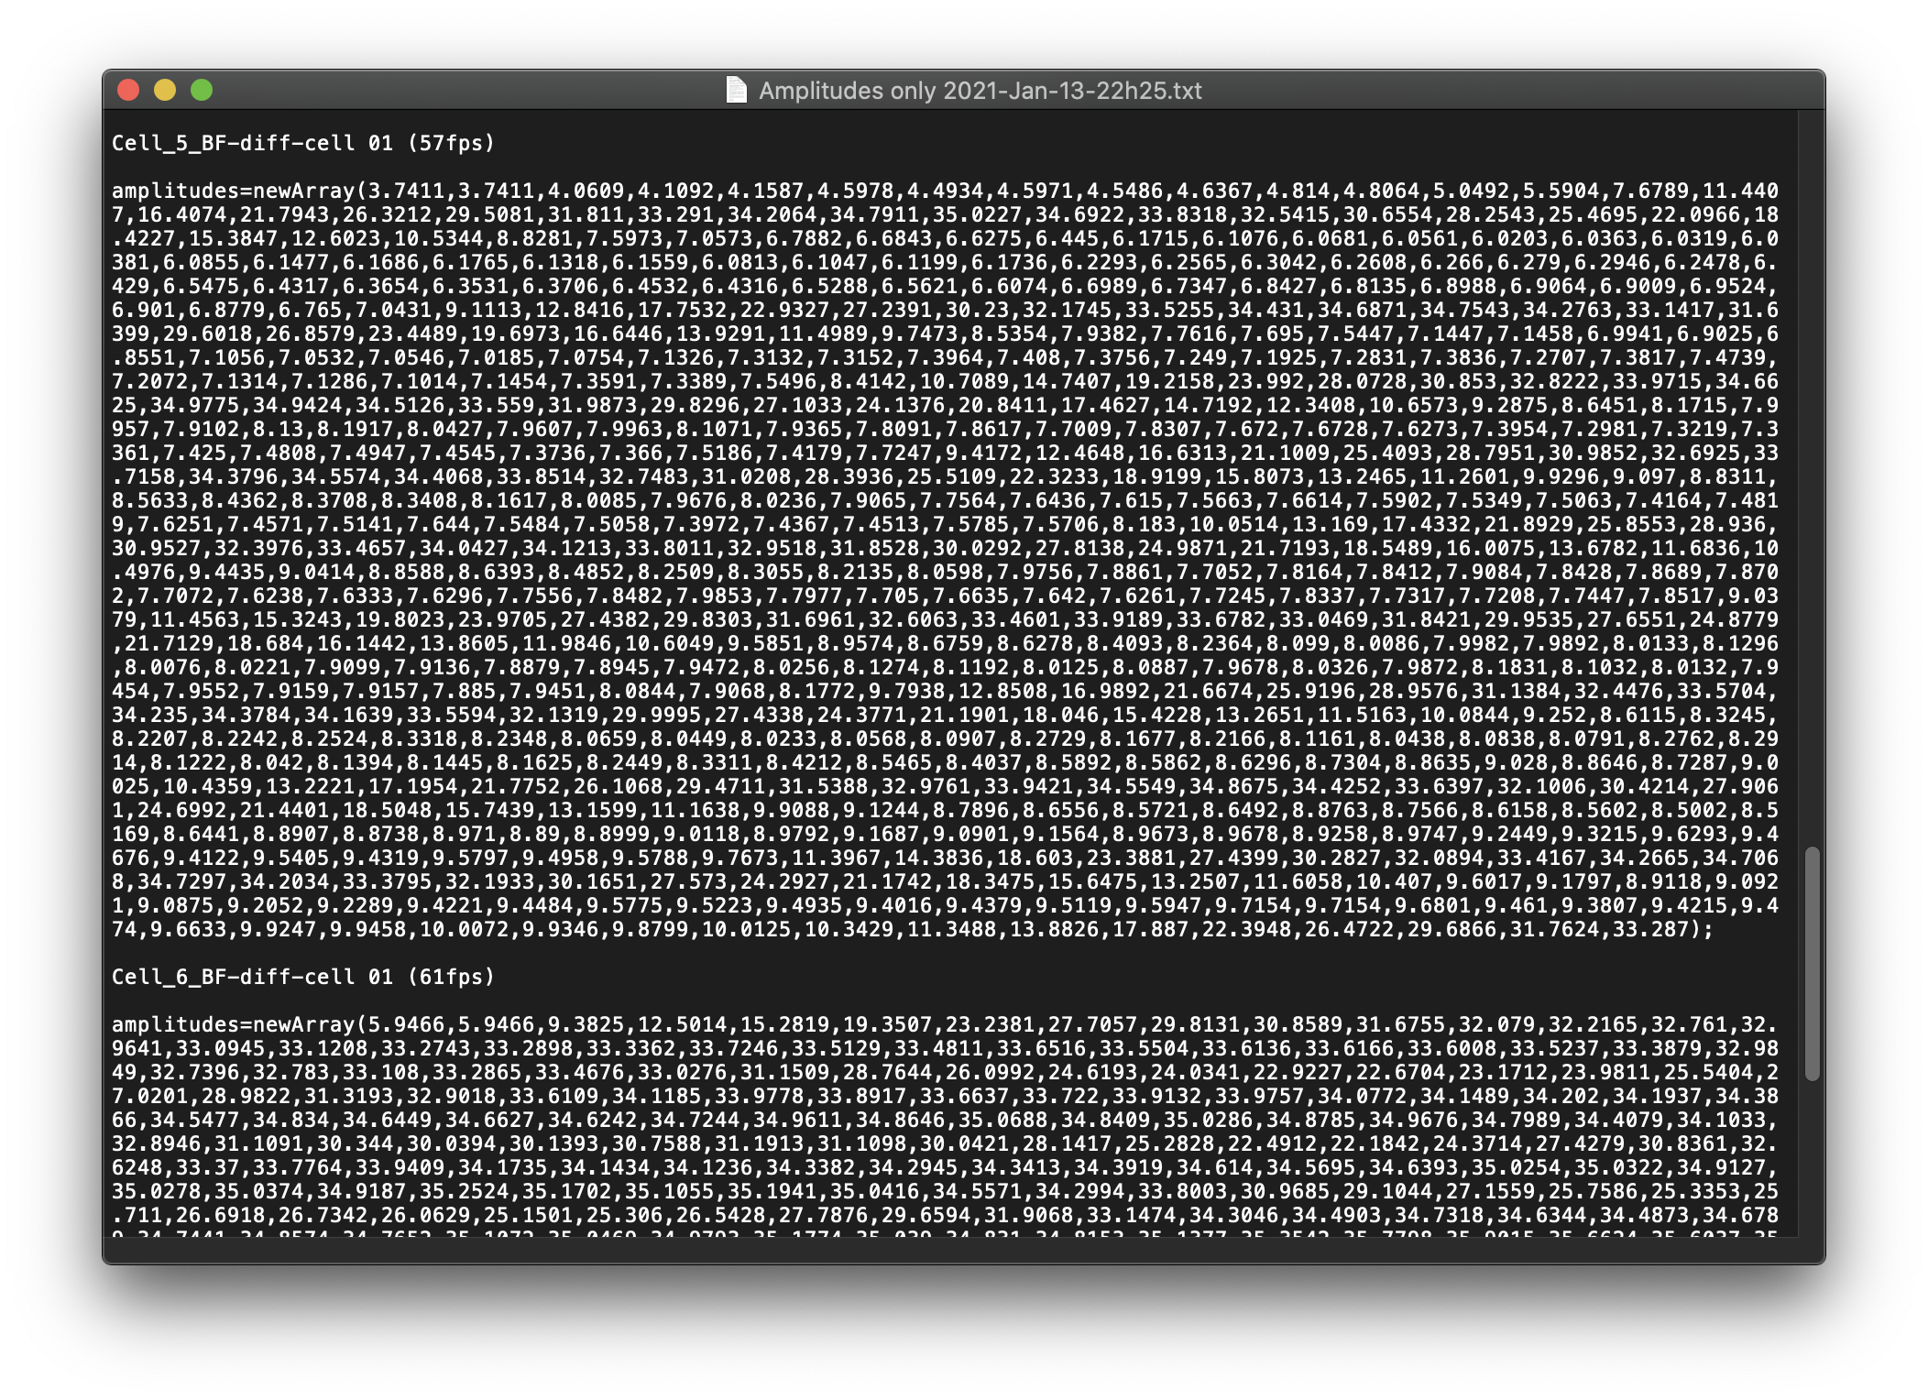
Myocyter output
The data we will be working with is an array of amplitudes
The frames per second is also found in the title. (57 fps)

Slide 10
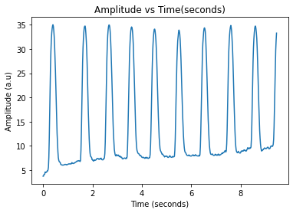
End result
To create this graph, we need points (x,y) where x = time (s) and y = amplitude
Thus need two array one of time values and one of amplitude values

Slide 11
Amplitude array
First, create a variable of an array of amplitudes by copy and pasting the list of amplitudes
Np.array([ HERE])
The pathname method without copy/paste will be discussed later

Slide 12
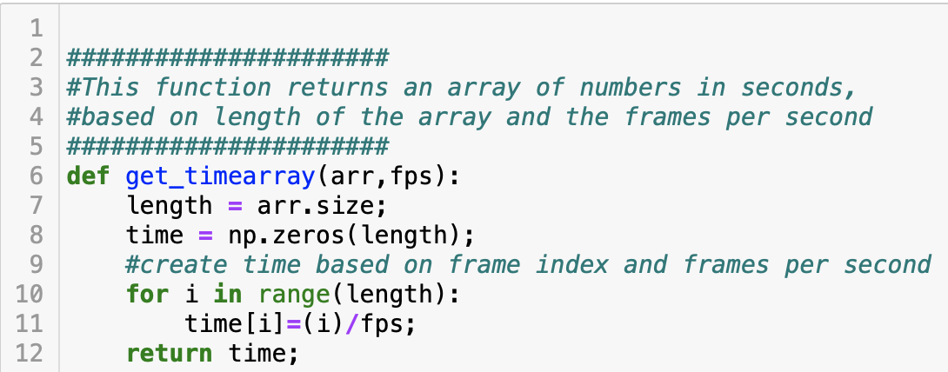
Time array
Arr =array of amplitudes
Fps = frames per second for that cell video
i = frame #
Ex: time[2] then refers to the time at of the third frame
Arr[2] refers to amplitude of data at third frame

Slide 13
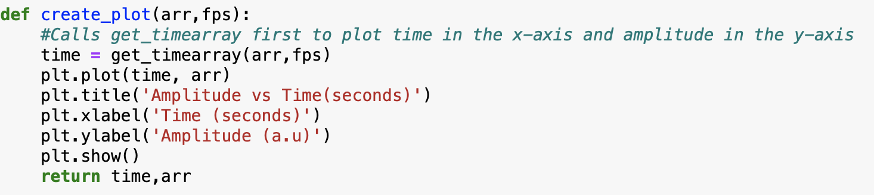
Create plot (basic)

Slide 14
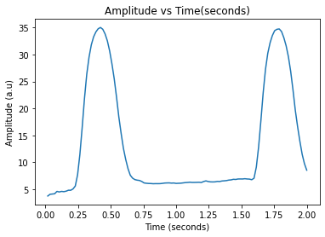
Small plot given time

Slide 15
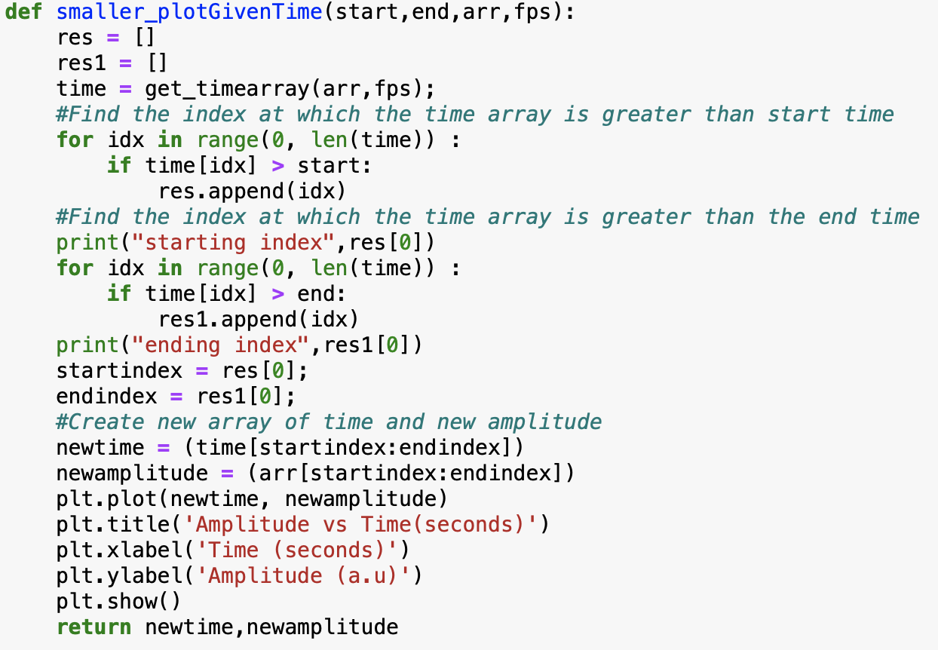
Small plot given time
Get time array
Find index at which time is greater than start time
Find index at which time is greater than end time
Use array slicing to create new arrays

Slide 16
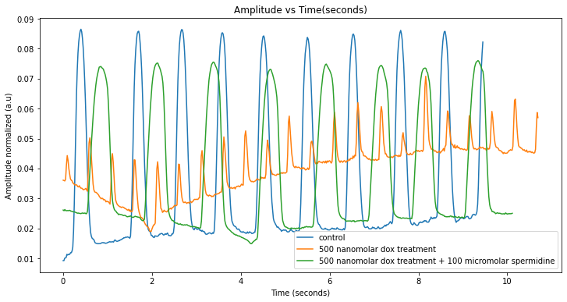
Plot multiple dataset

Slide 17
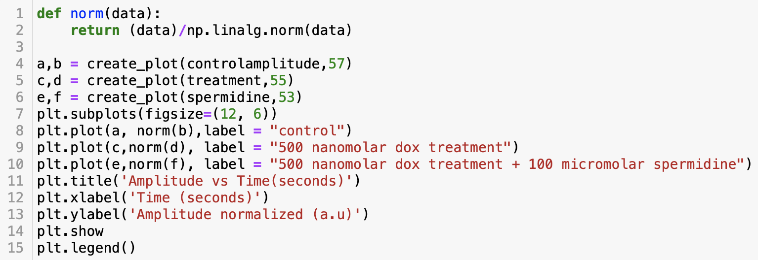
Call create_plot three times
Plot each dataset with a label
Give the plot a title, x axis label, and y axis label
Call plt.legend() to display a legend

Slide 18
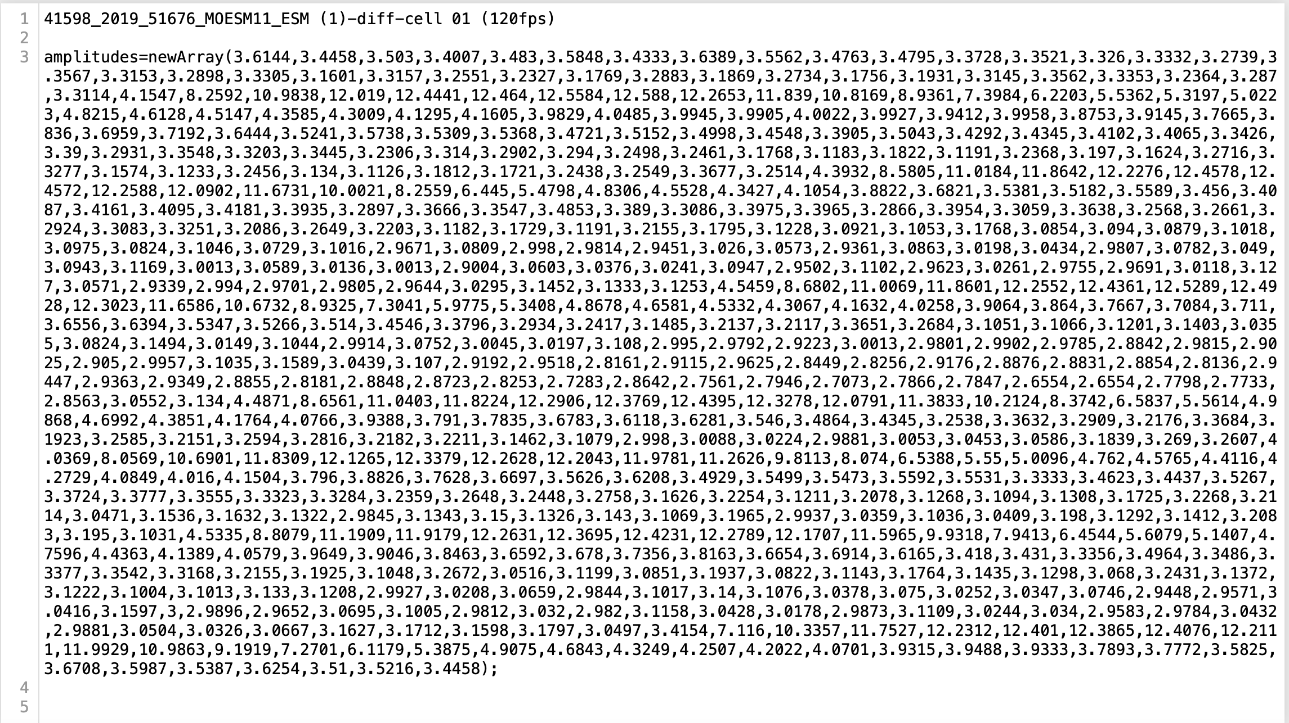
Creating from a pathfile
This txt file is named ‘mouseheart.txt’
As it belongs in the same folder as our code, the pathname is simply ‘mouseheart.txt’

Slide 19
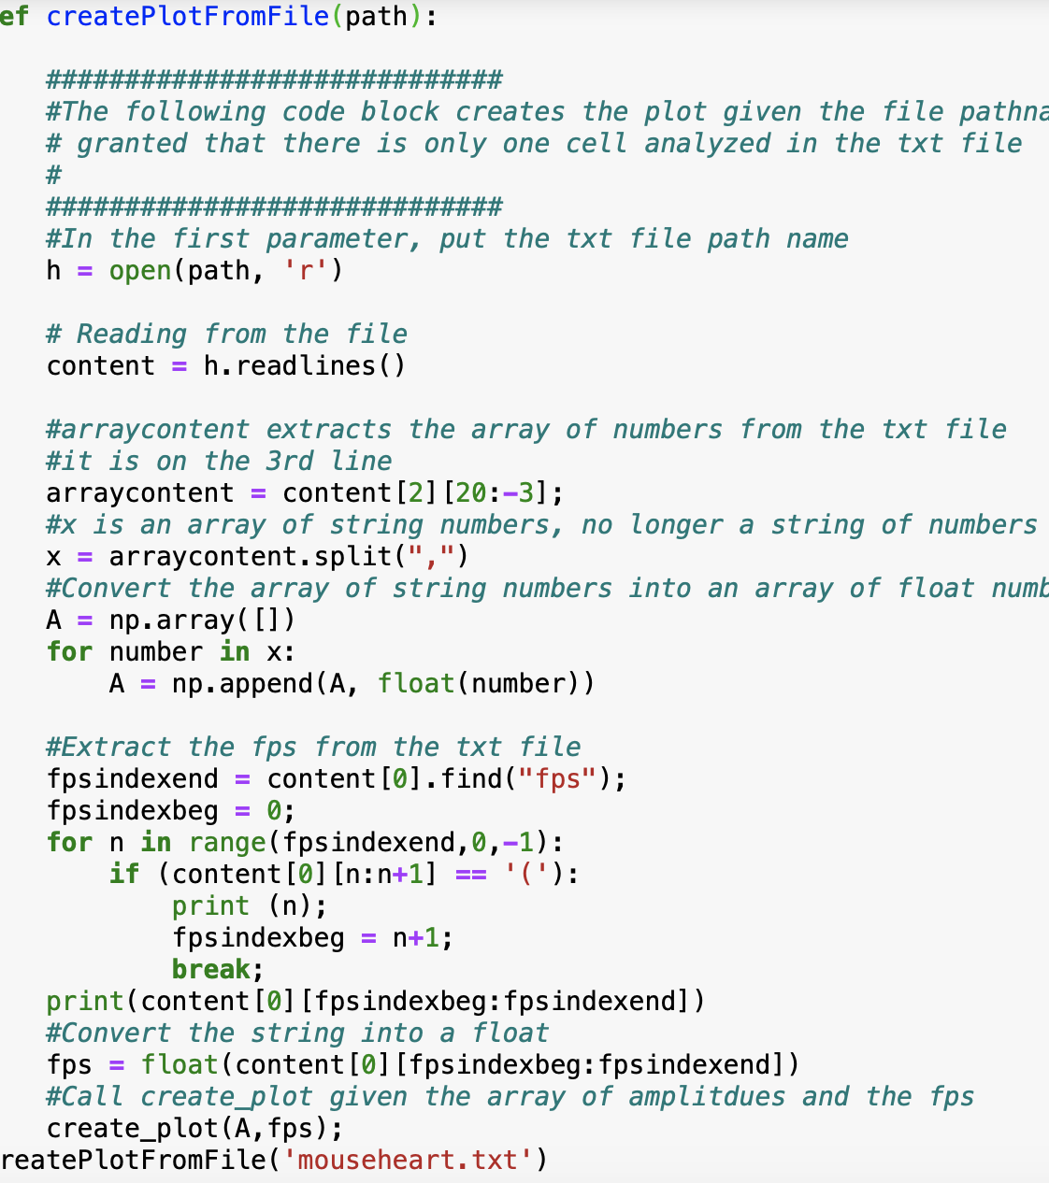
Given txt file
Open txt file into variable , h
The readlines() method returns a list containing each line in the file as a list item.
Arraycontent is a substring of the numbers from the third line
X is an array of numbers of type string
Create an array of numbers of type float
Extract the fps by the find function
Call create_plot at the end

Slide 20
Graphing from tfm data

Slide 21
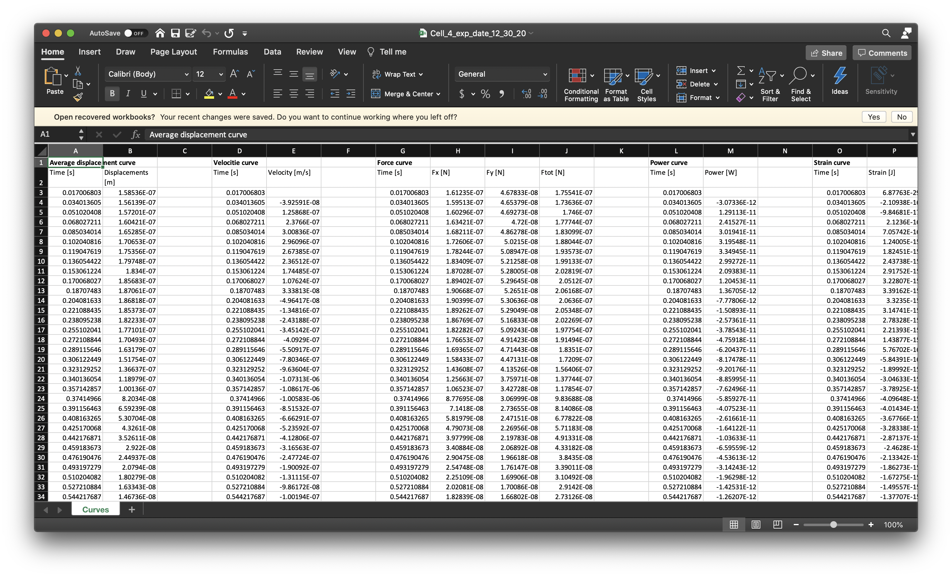
Excel sheet
Time values are already given, no need to create based off of fps

Slide 22
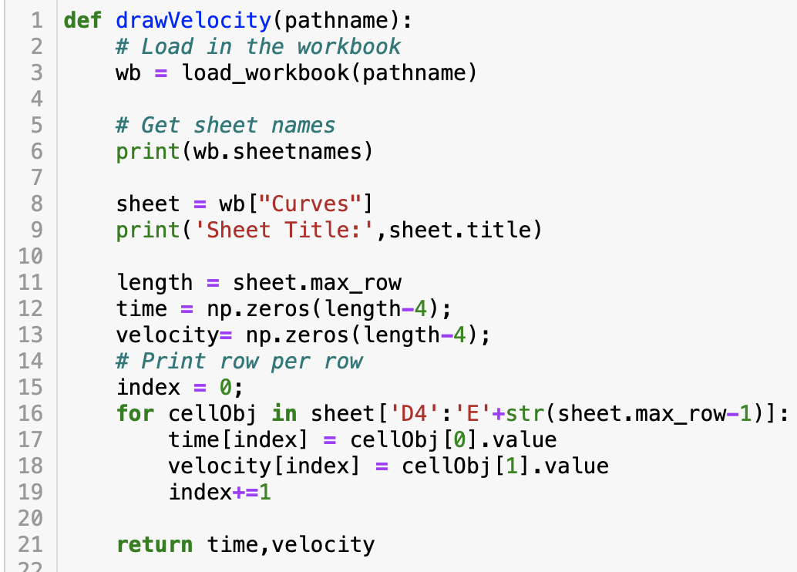
Draw velocity
Load_workbook is from openpyxl library
Extract the sheet labeled “Curves”
Find the maximum row where data ends
For velocity column, first three rows as well as last row are invalid values

Slide 23
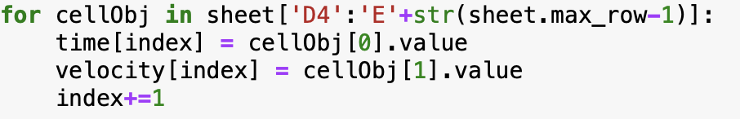
celObj

Slide 24
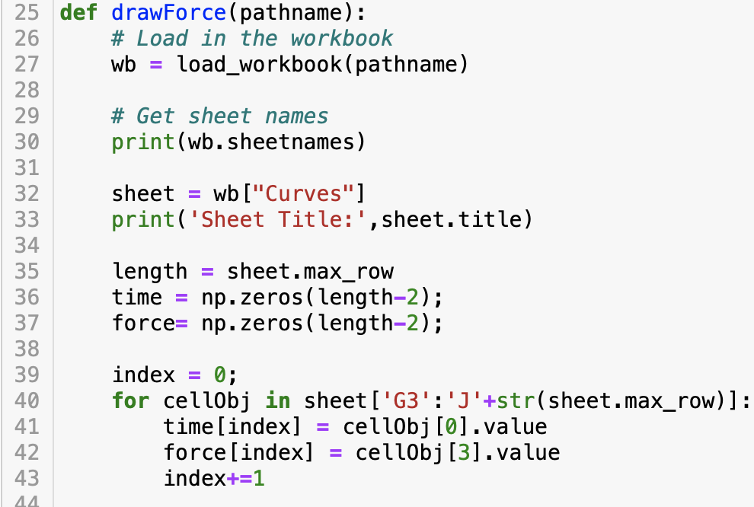
Draw Force
Only the two top values are invalid numbers
The last value is not invalid
cellObj now contains four items, we only care about the first and last item

Slide 25
Few matplotlib functions
plt.xticks(np.arange(0, 11, step=1))
plt.axis([0,5,-.15,.18])
plt.subplots(figsize=(15, 8))
X axis is from 0 to 11 with ticks every 1 step
X-axis is from 0 to 5. Y-axis is from -0.15 to 0.18
Figure size is length 15 and width 8

Slide 26
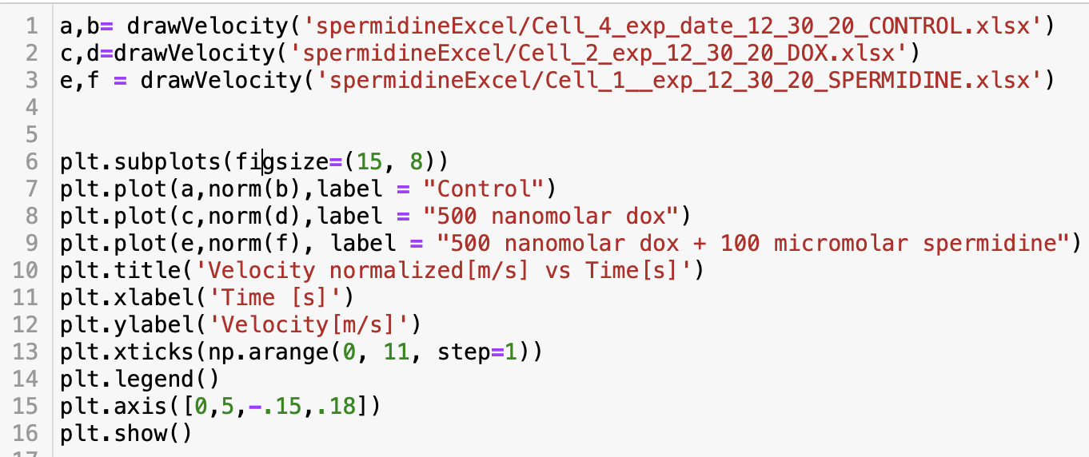

Slide 27
The end

